Slide 1
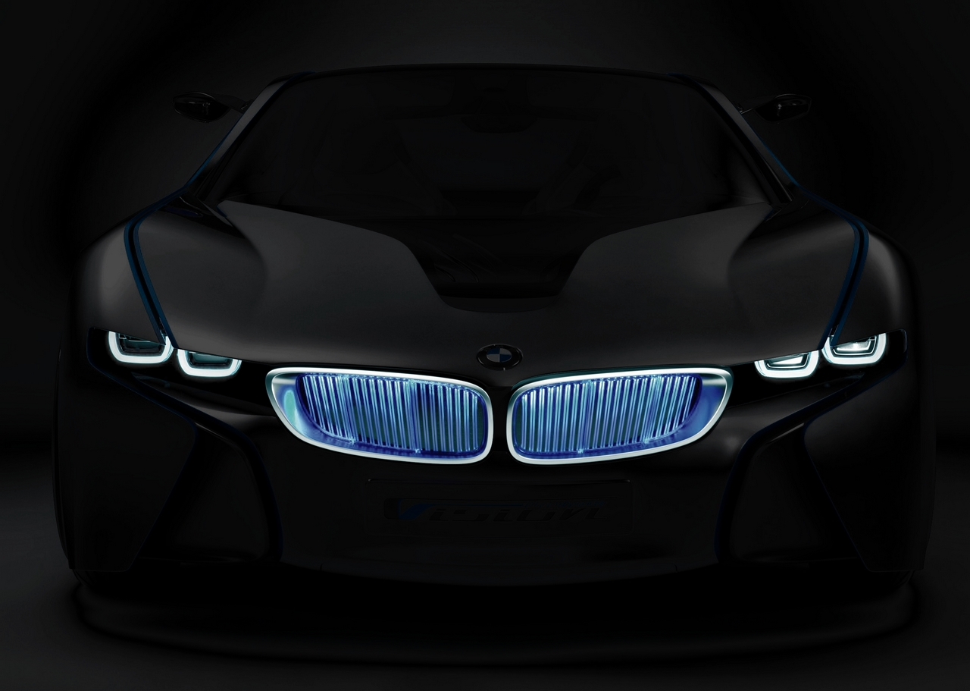
BMW’s Green Project
Nizar Kabbani
Rajab Ghazzawi
Diala Lababidi

Slide 2
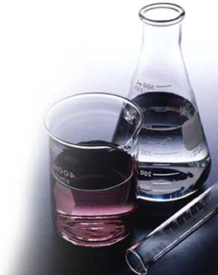
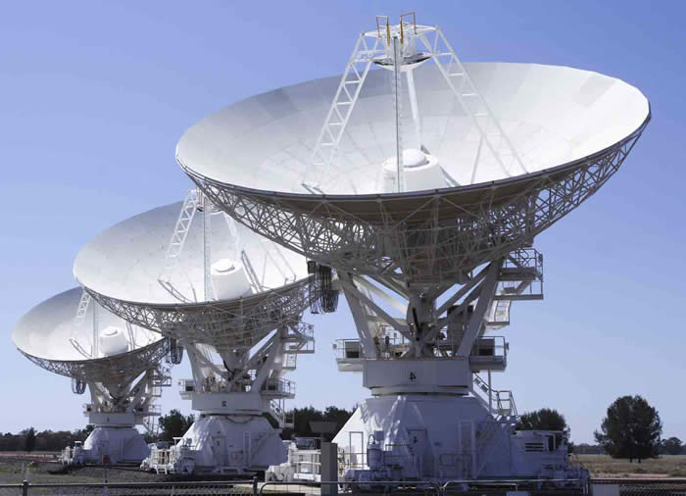
The Researchers
Diala Lababidi
Chemical Engineer
Nizar Kabbani
Electric and Computer Engineer
Rajab Ghazzawi
Computer and Communications Engineer

Slide 3
Research Methodology
A survey conducted among AUB students
Brainstorming
Browsing the internet

Slide 4
Environmental Benefits

Slide 5
Continued
The operation of automobiles is responsible for 14% of the total amount of greenhouse gases.
Hybrid cars run on electric engines, gasoline engine is used only to recharge.
In short, the amount of greenhouse gases released by this type of cars is minimal.

Slide 6
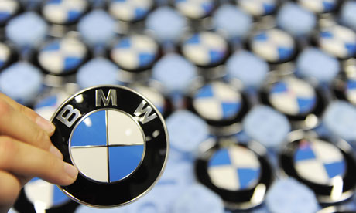
Marketing
Customers are more likely to buy cars from a company that advertised itself as being “green”
Receive financial support from government
“Green washing”: false statement that a technology is green in order to serve marketing and sales purposes.

Slide 7
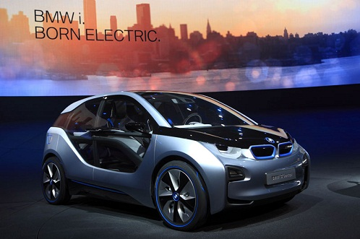
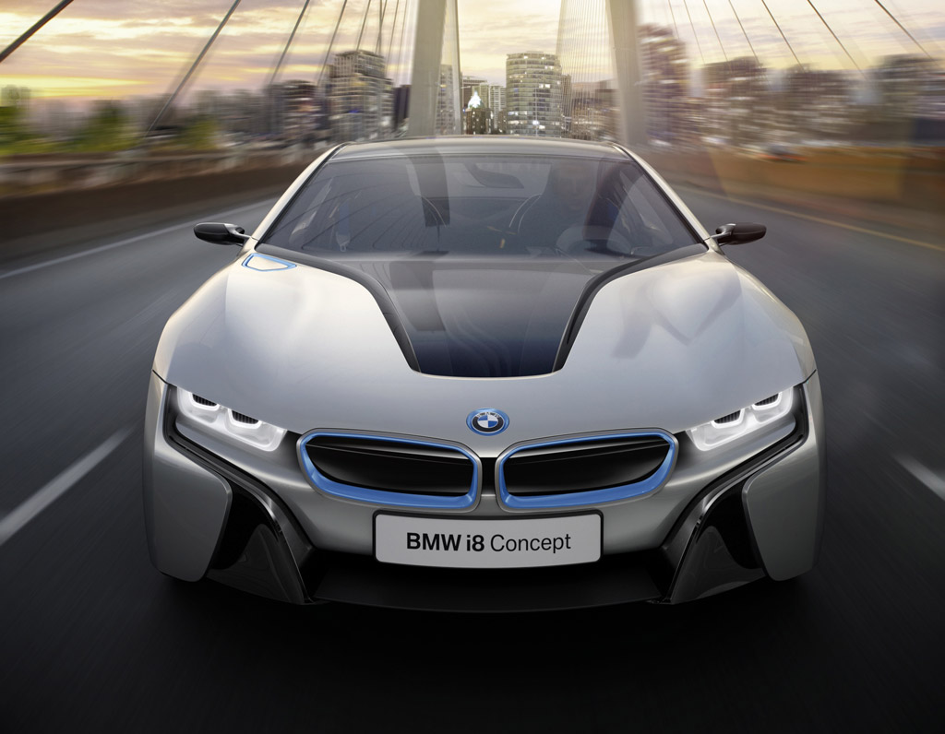
i-project
i3 megacity car:
i8 sports hybrid car:

Slide 8
i3

Slide 9
The Best of Both Worlds: i8

Slide 10
Hydrogen Power
Environment:
Hydrogen-powered engines only release water in liquid and vapor form.

Slide 11
EQ. of Combustion
2H₂
+ O₂
→ 2H₂O

Slide 12
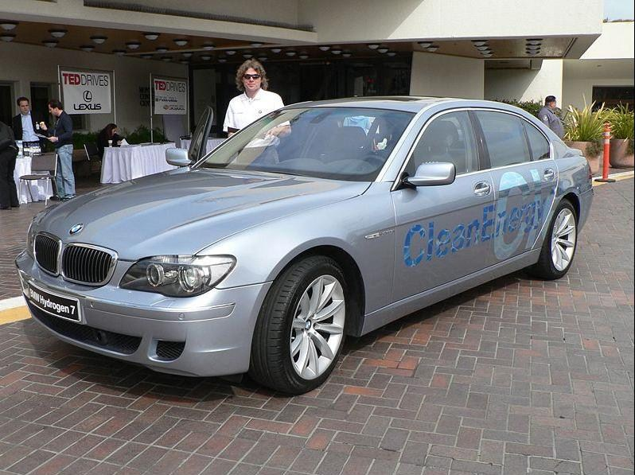
Hydrogen 7 series
The first “production-ready hydrogen vehicle”.

Slide 13
Hydrogen Cont’d
Didn’t reach popularity because of lack of advertisement.
Monetary and energy costs greater than that of a normal car.
Producing hydrogen requires techniques harmful to the environment.

Slide 14
EQ. of Electrolysis

Slide 15
Efficient Dynamics
Minimizing the drag coefficient caused by the car body’s resistance to wind during motion.
Engine more efficient by reducing internal friction which would mean that it wears out slower than is usually the case.

Slide 16
Preview: Efficient Dynamics

Slide 17
Survey

Slide 18
Results and Data Analysis:
The research was distributed equally between both genders.
The type of cars students preferred is summarized in the chart below:

Slide 19
Results Cont’d
100% of the students ranked BMW on a scale between 7-10. This shows that BMW is widely recognized for its unique cars and engines, and can successfully accomplish a project.

Slide 20
Chart

Slide 21
Contribution
65% of the students thought that BMW’s Green Project will highly contribute to the reduction of pollution due to the following reasons:
1. BMW’s international and worldwide reputation.
2. BMW’s unique designs and cars that resemble excellent performance and durability.
3. BMW’s ability to use innovate approaches to accomplish their goals.

Slide 22
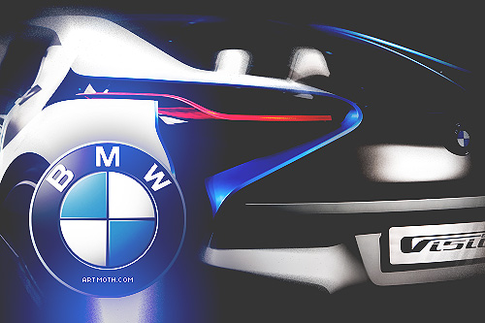
Thank You!!
Questions?

